Slide 1
Stored Procedures (Cont.), Functions, Triggers and More About Pl/SQL Constructs in MySQL Prof Dr Melike Sah Direkoglu
Slide credit: https://dev.mysql.com/doc/refman/8.0/en/sql-compound-statements.html.
Notes:
Functions

Slide 2
Basic Programming Structures in MySQL
Stored Procedures
Blocks of code stored in the database that are pre-compiled.
They can operate on the tables within the database and return scalars or results sets.
Functions
Can be used like a built-in function to provide expanded capability to your SQL statements.
They can take any number of arguments and return a single value.
Triggers
Kick off in response to standard database operations on a specified table.
Can be used to automatically perform additional database operations when the triggering event occurs.

Slide 3
More About Stored Procedures in MySQL
A stored procedure contains a sequence of SQL commands stored in the database catalog so that it can be invoked later by a program
Stored procedures are declared using the following syntax:
Create Procedure <proc-name>
(param_spec₁, param_spec₂, …, param_spec_{n} )
begin
-- execution code
end;
where each param_spec is of the form:
[in | out | inout] <param_name> <param_type>
in mode: allows you to pass values into the procedure,
out mode: allows you to pass value back from procedure to the calling program

Slide 4
More about Stored Procedures
You can declare variables in stored procedures
Can have any number of parameters.
Each parameter has to specify whether it’s in, out, or inout.
The typical argument list will look like
(out ver_param varchar(25), inout incr_param int …)
Be careful of output parameters for side effects.
Your varchar declarations for the parameters have to specify the maximum length.
The individual parameters can have any supported MySQL datatype.
They can be called using the call command, followed by the procedure name, and the arguments.
You can use flow control statements (conditional IF-THEN-ELSE or loops such as WHILE and REPEAT)

Slide 5
VARIABLE Declaration
DECLARE variable_name datatype(size) DEFAULT default_value;
Variable naming rules: Identifiers can consist of any alphanumeric characters, plus the characters '_' and '$'. Identifiers can start with any character that is legal in an identifier, including a digit. However, an identifier cannot consist entirely of digits.
Data types:A variable can have any MySQL data types. For example:
Character: CHAR(n), VARCHAR(n)
Number: INT, SMALLINT, DECIMAL(i,j), DOUBLE
Date: DATE, TIME, DATETIME
BOOLEAN
http://www.mysqltutorial.org/mysql-data-types.aspx

Slide 6
Variable Examples
DECLARE x, y INT DEFAULT 0;
DECLARE today TIMESTAMP DEFAULT CURRENT_DATE;
DECLARE ename VARCHAR(50);
DECLARE no_more_rows BOOLEAN;
SET no_more_rows = TRUE;

Slide 7
Assigning Variables
Using the SET command:
DECLARE total_count INT DEFAULT 0;
SET total_count = 10;
Using the SELECT INTO command:
DECLARE total_products INT DEFAULT 0;
SELECT COUNT(*) INTO total_products
FROM products;

Slide 8
Select Into
SELECT columns separated by commas
INTO variables separated by commas
FROM tablename
WHERE condition;
Ex:
SELECT cid, cname INTO custID, customername
FROM customer
WHERE cid = ‘c01’;

Slide 9
Arithmetic and String Operators
Arithmetic operators:
+, -, *, /
Modulo operator:
% or mod
Other math calculations use math functions: Pow(x,y)
Concatenation uses CONCAT function:
SELECT CONCAT('New ', 'York ', 'City');

Slide 10
MySQL Comparison Operators
EQUAL(=)
LESS THAN(<)
LESS THAN OR EQUAL(<=)
GREATER THAN(>)
GREATER THAN OR EQUAL(>=)
NOT EQUAL(<>,!=)

Slide 11
Logical Operators
Logical AND:
AND, &&
UnitsInStock < ReorderLevel AND CategoryID=1
UnitsInStock < ReorderLevel && CategoryID=1
Negates value:
NOT, !
Logical OR:
OR, ||
CategoryID=1 OR CategoryID=8
CategoryID=1 || CategoryID=8

Slide 12
Conditions
IF ELSE
CASE

Slide 13
IF Statement
IF statement: The IF statement can have THEN, ELSE, and ELSEIF clauses, and it is terminated with END IF.
IF variable1 = 0
THEN SELECT variable1;
END IF;
Ex:
IF param1 = 0
THEN SELECT 'Parameter value = 0’;
ELSE SELECT 'Parameter value <> 0’;
END IF;

Slide 14
Case Statement
Two different syntaxes:
CASE <expression>
WHEN <value> then
<statements>
WHEN <value> then
<statements>
…
ELSE
<statements>
END CASE;

Slide 15
CASE Statement (Continued)
CASE
WHEN <condition> then
<statements>
WHEN <condition> then
<statements>
…
ELSE
<statements>
END CASE;

Slide 16
Case Statement (In a Procedure Example)
DELIMITER //
CREATE PROCEDURE proc_CASE(IN param1 INT)
BEGIN
DECLARE variable1 INT;
SET variable1 = param1 + 1;
CASE variable1
WHEN 0 THEN
INSERT INTO table1 VALUES (param1);
WHEN 1 THEN
INSERT INTO table1 VALUES (variable1);
ELSE
INSERT INTO table1 VALUES (99);
END CASE;
END//
DELIMITER;

Slide 17
Loop Control Flow
Iterate <label> – start the loop again
Can only be issued within LOOP, REPEAT, or WHILE statements
Works much like the “continue” statement in Java or C++.

Slide 18
Loop
[begin_label:] LOOP
<statement list>
END LOOP [end_label]
Note that the end_label has to = the begin_label
Both are optional

Slide 19
Repeat until Loop
[begin_label:] REPEAT
<statement list>
UNTIL <search_condition>
END REPEAT [end_label]

Slide 20
While – Do Loop
[begin_label:] WHILE <condition> DO
<statements>
END WHILE [end_label]

Slide 21
WHILE cond DO statement (In a Procedure)
DELIMITER //
CREATE PROCEDURE proc_WHILE (IN param1 INT) BEGIN
DECLARE variable1, variable2 INT;
SET variable1 = 0;
WHILE variable1 < param1
DO INSERT INTO table1 VALUES (param1);
SELECT COUNT(*) INTO variable2 FROM table1;
SET variable1 = variable2; /*Update the control*/
END WHILE;
END//
DELIMITER;

Slide 22
Notes on the previous example
The DELIMITER // statement sets a session variable so that the // becomes the statement terminator.
For the purposes of that session, the “;” within the stored procedure are just like any other character.
When the stored procedure is run, however, the “;” function the way that they normally do in MySQL.
You always want to make the delimiter a “;” again when you change it.

Slide 23
Comment Syntax
From a /* sequence to the following */ sequence.
From a “#” character to the end of the line.
From a “-- ” sequence to the end of the line.
In MySQL, the “-- ” (double-dash) comment style requires the second dash to be followed by at least one whitespace
-- Programmer: John Smith

Slide 24
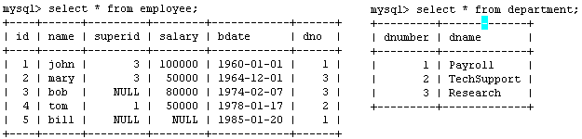
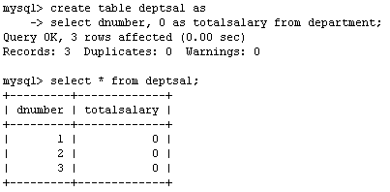
Example
Suppose we want to keep track of the total salaries of employees working for each department
We need to write a procedure to update the salaries in the deptsal table

Slide 25
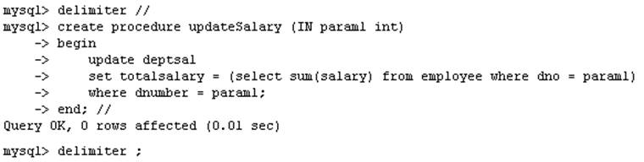
Example – Step 1
Step 1: Change the delimiter (i.e., terminating character) of SQL statement from semicolon (;) to something else (e.g., //) So that you can distinguish between the semicolon of the SQL statements in the procedure and the terminating character of the procedure definition

Slide 26
Example – Step 2
Step 2:
Define a procedure called updateSalary which takes as input a department number.
The body of the procedure is an SQL command to update the totalsalary column of the deptsal table.
Terminate the procedure definition using the delimiter you had defined in step 1 (//)

Slide 27
Example – Step 3
Step 3: Change the delimiter back to semicolon (;)

Slide 28
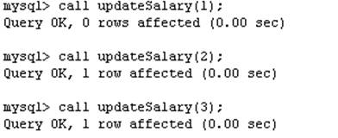
Example – Step 4
Step 4: Call the procedure to update the totalsalary for each department

Slide 29
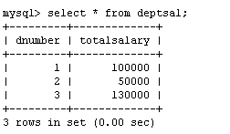
Example – Step 5
Step 5: Show the updated total salary in the deptsal table

Slide 30

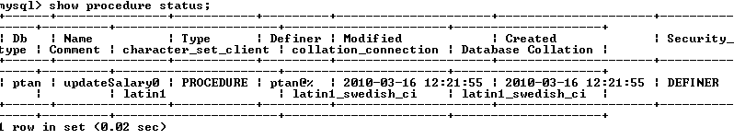
Stored Procedures in MySQL
Use show procedure status to display the list of stored procedures you have created
Or use Routines tab
Use drop procedure to remove a stored procedure

Slide 31
Using Cursors in Stored Procedures in MySQL
MySQL also supports cursors in stored procedures.
A cursor is used to iterate through a set of rows returned by a query so that we can process each individual row.
To learn more about stored procedures, go to:
http://www.mysqltutorial.org/mysql-stored-procedure-tutorial.aspx

Slide 32
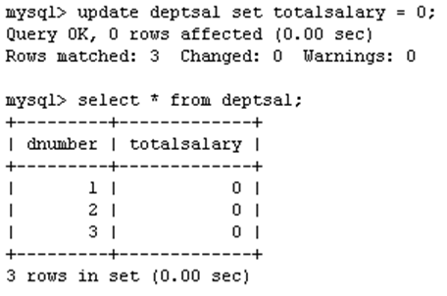
Example using Cursors
The previous procedure updates one row in deptsal table based on input parameter
Suppose we want to update all the rows in deptsal simultaneously
First, let’s reset the totalsalary in deptsal to zero (Part 1)

Slide 33
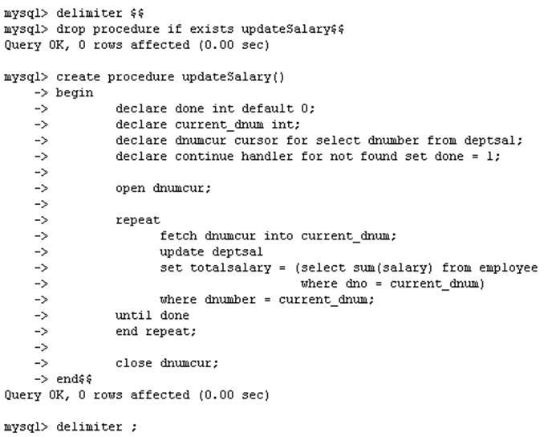
Example using Cursors – Part 2
Drop the old procedure
Use cursor to iterate the rows

Slide 34
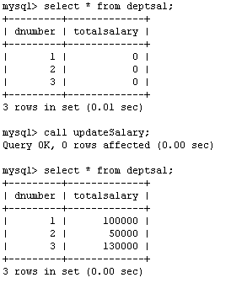
Example using Cursors – Part 3
Call procedure

Slide 35
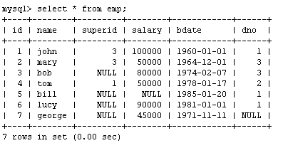
Another Example
Create a procedure to give a raise to all employees

Slide 36
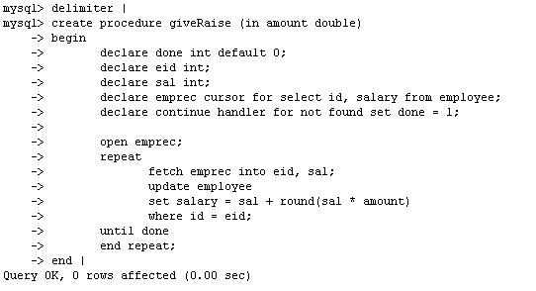
Another Example – Part 2

Slide 37
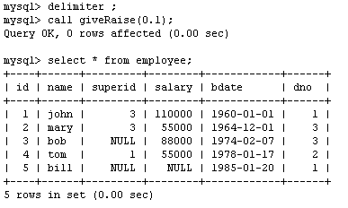
Another Example – Part 3

Slide 38
Functions
Your user-defined functions can act just like a function defined in the database.
They take arguments and return a single output.
The general syntax is: create function <name> (<arg1> <type1>, [<arg2> <type2> [,…]) returns <return type> [deterministic]
Deterministic means that the output from the function is strictly a consequence of the arguments.
Same values input → same values output.
Like a static method in Java.
Note that the arguments cannot be changed and the new values passed back to the caller.
Follow that with begin … end and you have a function.

Slide 39
Functions
You need ADMIN privilege to create functions on mysql-user server
Functions are declared using the following syntax:
function <function-name> (param_spec₁, …, param_spec_{k})
returns <return_type>
[not] deterministic allow optimization if same output
for the same input (use RAND not deterministic )
Begin
-- execution code
end;

Slide 40
Stored Functıons
Stored functions differ from stored procedures in that stored functions actually return a value.
Stored functions have only input parameters (if any parameters at all), so the IN , OUT , and INOUT keywords aren’t used.
Stored functions have no output parameters; instead, you use a RETURN statement to return a value whose type is determined by the RETURNS type statement, which precedes the body of the function.

Slide 41
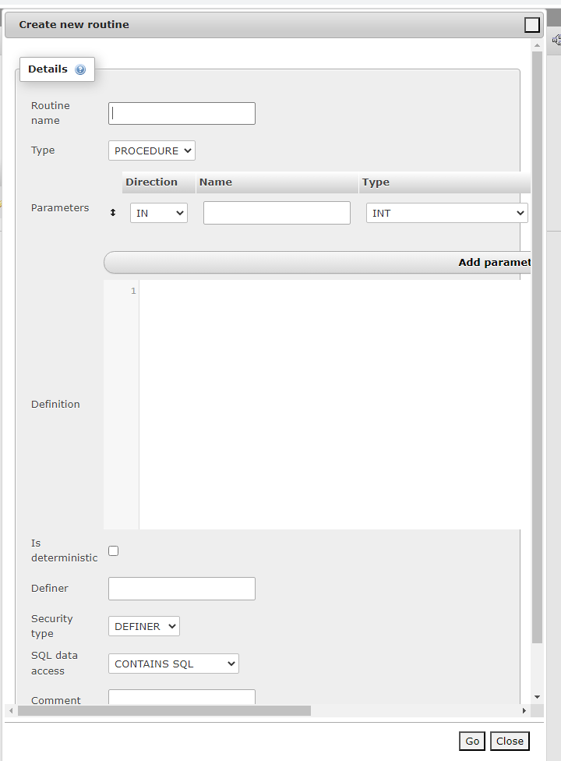
Creating stored function
Use SQL tab
Or use PhPMyAdmin Routines Tab →Add routine
Select function

Slide 42
Syntax of A stored Functıon
DELIMITER //
CREATE FUNCTION FunctionName([parameters]) RETURNS DATATYPE
DETERMINISTIC
SQL SECURITY DEFINER
COMMENT ‘A function’
BEGIN
SQL Statements
Return Variable;
END //
DELIMITER ;

Slide 43
Optional Characteristics
Type: Procedure/Function
Deterministic : If the procedure always returns the same results, given the same input. The default value is NOT DETERMINISTIC.
SQL Security : At call time, check privileges of the user.
INVOKER is the user who calls the procedure.
DEFINER is the creator of the procedure. The default value is DEFINER.
Comment : For documentation purposes; the default value is ""

Slide 44
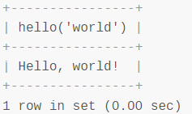
Example Stored Function
DELIMITER //
CREATE FUNCTION hello (s CHAR(20))
RETURNS CHAR(50) DETERMINISTIC
BEGIN
RETURN CONCAT('Hello, ',s,'!’);
END //
DELIMITER ;
Click SQL tab and write:
SELECT hello('world');

Slide 45
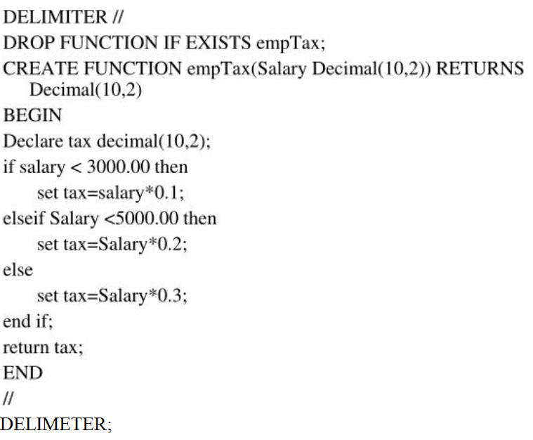
Example Stored Functıon

Slide 46
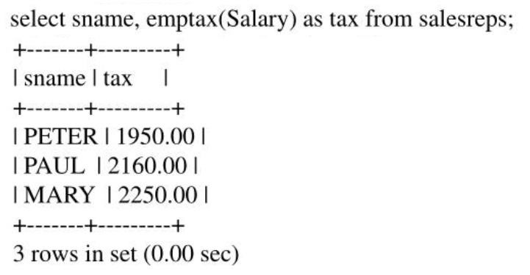
Calling the stored function within an SQL Query
Salary column pass to the emptax function as a parameter and the function returns the tax value for each person

Slide 47
A Function With Repeat Until Loop
DELIMITER //
CREATE FUNCTION CalcIncome ( starting_value INT )
RETURNS INT
BEGIN
DECLARE income INT;
SET income = 0;
label1: REPEAT
SET income = income + starting_value;
UNTIL income >= 4000
END REPEAT label1;
RETURN income;
END; //
DELIMITER ;

Slide 48
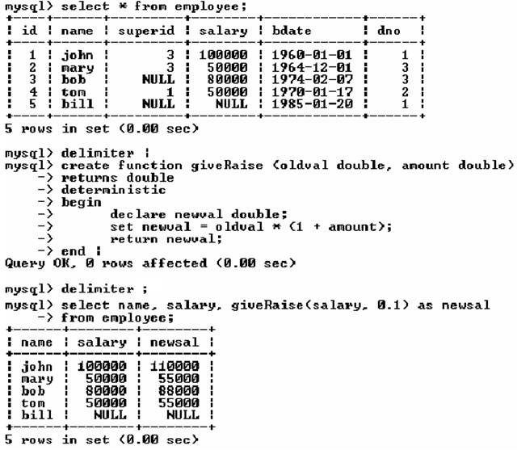
Another Example of Functions

Slide 49
Another Example of Functions

Slide 50
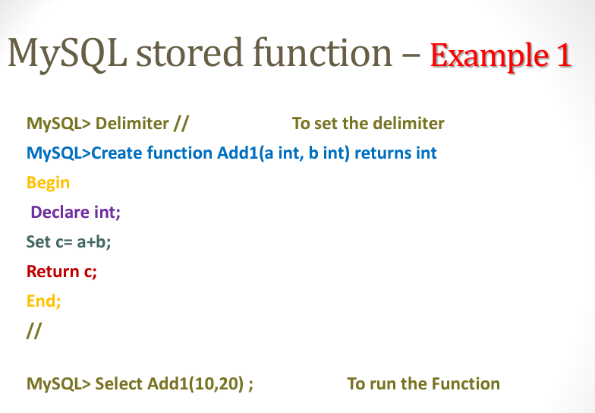
More Function Examples

Slide 51
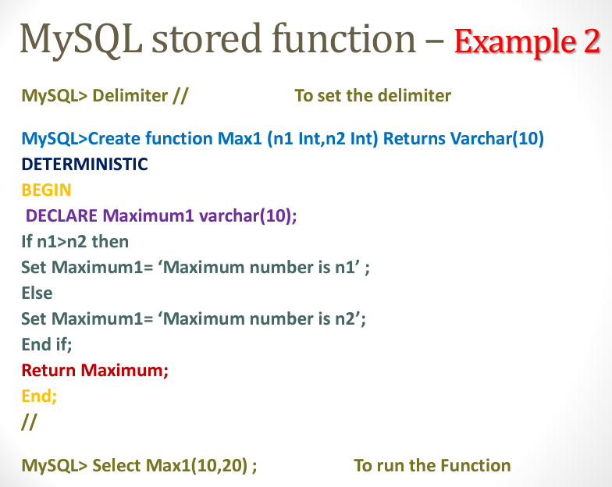

Slide 52
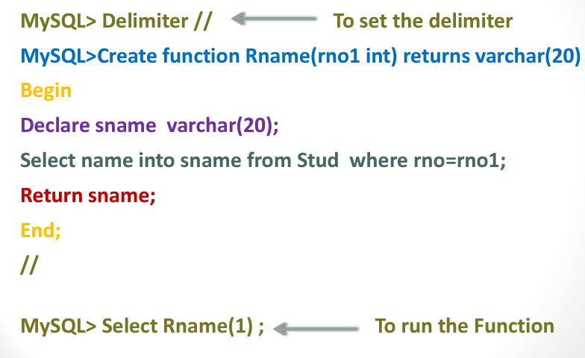

Slide 53
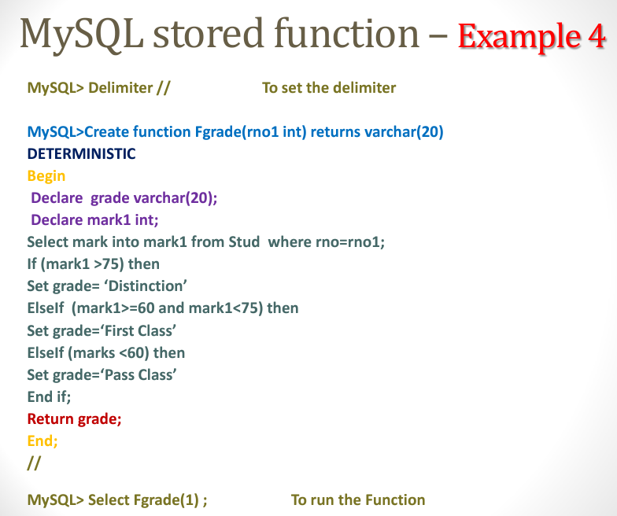

Slide 54
SQL Triggers
To monitor a database and take a corrective action when a condition occurs
Examples:
Charge $10 overdraft fee if the balance of an account after a withdrawal transaction is less than $500
Limit the salary increase of an employee to no more than 5% raise
CREATE TRIGGER trigger-name trigger-time trigger-event ON table-name FOR EACH ROW trigger-action;
trigger-time ∈ {BEFORE, AFTER}
trigger-event ∈ {INSERT,DELETE,UPDATE}

Slide 55
Triggers
Please see: https://dev.mysql.com/doc/refman/8.0/en/create-trigger.html
for the complete specification for triggers.
CREATE
[DEFINER = { user | CURRENT_USER }]
TRIGGER trigger_name
trigger_time trigger_event
ON tbl_name FOR EACH ROW
[trigger_order]
trigger_body
trigger_time: { BEFORE | AFTER }
trigger_event: { INSERT | UPDATE | DELETE }
trigger_order: { FOLLOWS | PRECEDES } other_trigger_name

Slide 56
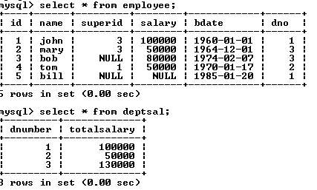
SQL Triggers: An Example
We want to create a trigger to update the total salary of a department when a new employee is hired

Slide 57
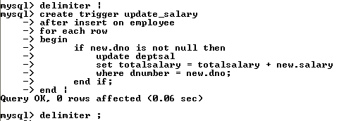
SQL Triggers: An Example – PART 1
Create a trigger to update the total salary of a department when a new employee is hired:
The keyword “new” refers to the new row inserted

Slide 58
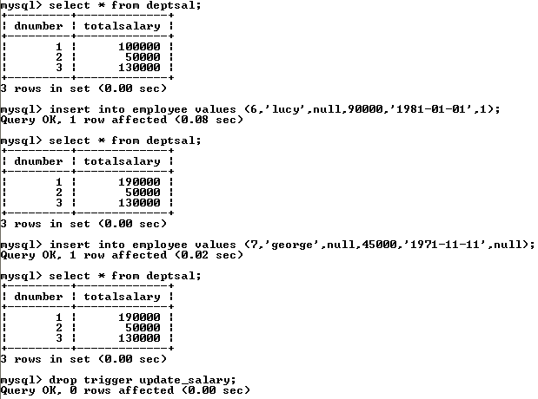
SQL Triggers: An Example – Part 2
Totalsalary of department 1 increases by 90000
totalsalary did not change, why?
To remove the trigger

Slide 59
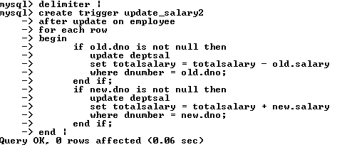
SQL Triggers: Another Example – Part 3
A trigger to update the total salary of a department when an employee tuple is modified:

Slide 60
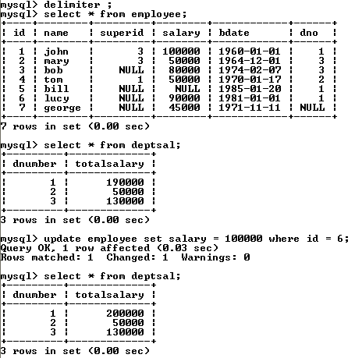
SQL Triggers: An Example – Part 4

Slide 61
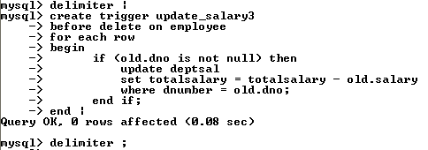
SQL Triggers: Another Example – Part 5
A trigger to update the total salary of a department when an employee tuple is deleted:

Slide 62
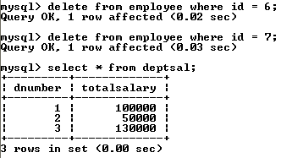
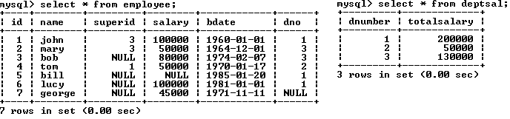
SQL Triggers: Another Example – Part 6

Slide 63
A Few Things to Note
A given trigger can only have one event.
If you have the same or similar processing that has to go on during insert and delete, then it’s best to have that in a procedure or function and then call it from the trigger.
A good naming standard for a trigger is <table_name>_event if you have the room for that in the name.
Just like a function or a procedure, the trigger body will need a begin … end unless it is a single statement trigger.

Slide 64
The Special Powers of a Trigger
While in the body of a trigger, there are potentially two sets of column values available to you, with special syntax for denoting them.
old.<column name> will give you the value of the column before the DML statement executed.
new.<column name> will give you the value of that column after the DML statement executed.
Insert triggers have no old values available, and delete triggers have no new values available for obvious reasons. Only update triggers have both the old and the new values available.
Only triggers can access these values this way.

Slide 65
Changing columns in a trigger
In the body of a trigger, it is possible to change the values for the columns in the current row.
Just use the “set” verb to change them.
You can only do this for an update or insert trigger.
You can only change the values of new.<column name> since there is no point to changing the old values.

Slide 66
More Examples
Simplified example of a parent table: hospital_room as the parent and hospital_bed as the child.
The room has a column: max_beds that dictates the maximum number of beds for that room.
The hospital_bed table has a before insert trigger that checks to make sure that the hospital room does not already have its allotted number of beds.

Slide 67
The Trigger
CREATE DEFINER=`root`@`localhost`
TRIGGER `programming`.`hospital_bed_BEFORE_INSERT`
BEFORE INSERT ON `hospital_bed` FOR EACH ROW
BEGIN
declare max_beds_per_room int;
declare current_count int;
select max_beds into max_beds_per_room
from hospital_room
where hospital_room_no = new.room_id;
select count(*) into current_count
from hospital_bed
where room_id = new.room_id;
if current_count >= max_beds_per_room then
signal sqlstate '45000' set message_text='Too many beds in that room already!';
end if;
END;

Slide 68
Firing the trigger
insert into hospital_bed (room_id, hospital_bed_id)
values ('323B', 1);
insert into hospital_bed (room_id, hospital_bed_id)
values ('323B', 2);
insert into hospital_bed (room_id, hospital_bed_id)
values ('323B', 3);
insert into hospital_bed (room_id, hospital_bed_id)
values ('323B', 4);
insert into hospital_bed (room_id, hospital_bed_id)
values ('323B', 5);
Error Code: 1644. Too many beds in that room already!

Slide 69
Using a Stored Procedure Instead
CREATE DEFINER=`root`@`localhost` PROCEDURE `too_many_beds`(in room_id varchar(45))
BEGIN
declare max_beds_per_room int;
declare current_count int;
declare room_count int;
-- see if the hospital room exists
select count(*) into room_count
from hospital_room
where hospital_room_no = room_id;
if room_count = 1 then -- we can see if room for 1 more bed
begin
select max_beds into max_beds_per_room
from hospital_room
where hospital_room_no = room_id;
-- count the beds in this room
select count(*) into current_count
from hospital_bed
where room_id = room_id;
if current_count >= max_beds_per_room then
-- flag an error to abort if necessary
signal sqlstate '45000' set message_text='Too many beds in that room already!';
end if;
end;
end if;
END

Slide 70
Comments on the Procedure
Because that is in isolation from the beds table, we have to check to make sure that the room number is viable.
As a stored procedure, this can be called directly from the command line as a means of unit testing.
I’m still not too sure how exacting the typing of the parameters has to be. For instance, does that one argument have to be exactly a varchar(45) in order for it to work, or not?

Slide 71
Viewing Your Triggers
MySQL has a schema that has tables for all of the information that is needed to define and run the data in the database. This is meta data.
select * from information_schema.triggers where trigger_schema=‘<your schema name>'; -- retrieve the trigger information for the triggers in <your schema name>.
Alternatively, you can use the “show triggers” command (this is not SQL) that will display a report of your triggers from the default schema.
mysql> show triggers;

Slide 72
Viewing Your Triggers (Continued)
If you’re using MySQL Workbench, the IDE provides access to your triggers:
In the navigator pane, right click the table that has the trigger.
Select "Alter Table"
This will open up a rather lavish dialog which has tabs down near the bottom. One of those tabs is "Triggers". Select that.
That will open up another dialog, and over to the left will be the list of events that you can define triggers for.
At this point, you can right click one of those events and it will pop up a menu that will give you the option to create a new trigger for that event.
Or you can double click an existing trigger to get into an editor on that particular trigger. This will allow you to update the trigger in place as it were, rather than drop and recreate it.

Slide 73
Dynamic SQL
Sometimes you need to operate against a table or columns that are not known at compile time. MySQL has a process using set, prepare, execute, and deallocate.
CREATE DEFINER=`root`@`localhost` PROCEDURE `dynamic`(in tableName varchar(40))
begin
set @statement = concat('select * from ', tableName);
prepare stmt from @statement;
execute stmt;
set @statement = concat('select count(*) from ', tableName, ' into @count');
prepare stmt from @statement;
execute stmt;
select concat('Count was: ', @count, ' from table: ', tableName);
deallocate prepare stmt;
end

Slide 74
Dynamic SQL (Continued)
The @ in front of a name makes it a user variable, which is shared between the command session and the stored procedure.
concat will take any number of arguments.
Just like the Java API, you can have bind variables in the SQL that you submit, then use the using clause in the execute statement.
The bind variables have to map one for one to the variables in the using clause: execute stmt using @var1, @var2, …

Slide 75
Credits
Presentation taken from:
www.cse.msu.edu/~pramanik/teaching/courses/cse480/14s/lectures/12/lecture13.ppt by Sakti Pramanik at Michigan State University
MySQL Procedural Language by David Brown at California State University Long Beach

Slide 76
More Trıgger Examples
https://phoenixnap.com/kb/mysql-trigger

